Slide 1

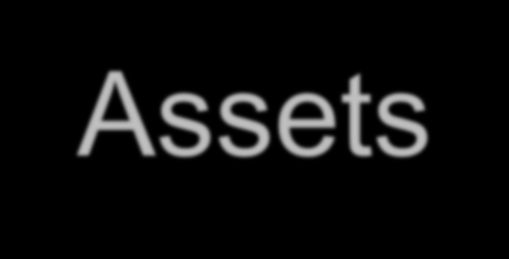
Security of Information Assets
By Vinod Sencha
Core Faculty(IS), RTI Jaipur

Slide 2



Learning Objectives
Security threats to
data
hardware and
users,
common types of hacking,
protective measures

Slide 3


IT Security
IT security is the protection of computer systems and networks from information disclosure, theft of or damage to their hardware, software, or electronic data, as well as from the disruption or misdirection of the services they provide.
IT security performs four important functions for an organization:
Protects the organization’s ability to function
Enables the safe operation of applications implemented on the organization’s IT systems
Protects the data the organization collects and uses
Safeguards the technology assets in use at the organization

Slide 4

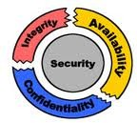
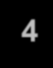
IT Security: Features
Confidentiality:-
Assurance
that information is
shared only among authorized persons or organizations.
Integrity:-
Assurance that the information is authentic and complete.
Maintaining and assuring the accuracy and consistency of data over its entire life-cycle.
Availability:-
Assurance that the systems responsible for delivering, storing and processing information are accessible when needed, by those who need them.

Slide 5
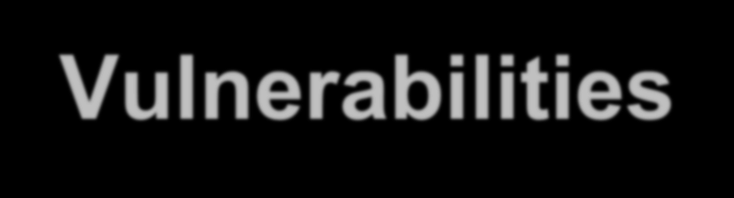
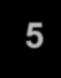
Vulnerabilities
A vulnerability is a weakness which can be exploited by a threat actor, such as an attacker, to cross privilege boundaries (i.e. perform unauthorized actions) within a computer system.
Vulnerabilities are classified according to the asset class they are related to:-
Hardware:-
Software:-
Network:-
Personnel:-
Physical site:-
Susceptibility to humidity/dust ; Unprotected storage; Over-heating.
Insufficient testing; insecure coding; lack of audit trail;
Design flaw.
Unprotected communication lines; Insecure network architecture.
Inadequate recruiting process; Inadequate awareness; insider threat
Area subject to natural disasters (e.g. flood,
earthquake); interruption to power source
security
Organizational:- Lack of regular audits; lack of continuity plans;

Slide 6

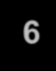
Threats
A threat is a potential negative action or event facilitated by a vulnerability that results in an unwanted impact to a computer system or application.
Any circumstance or event with the potential to adversely impact an IS through unauthorized access, destruction, disclosure, modification of data, and/or denial of service.
A countermeasure is any step you take to ward off a threat
to protect user, data, or computer from harm.
Various Security threats:-
Users:- Identity Theft; Loss of Privacy; Exposure to Spam; Physical Injuries.
Hardware:- Power-related problems; theft; vandalism; and natural disasters.
Data:- Malwares; Hacking; Cybercrime; and Cyber-terrorism.

Slide 7
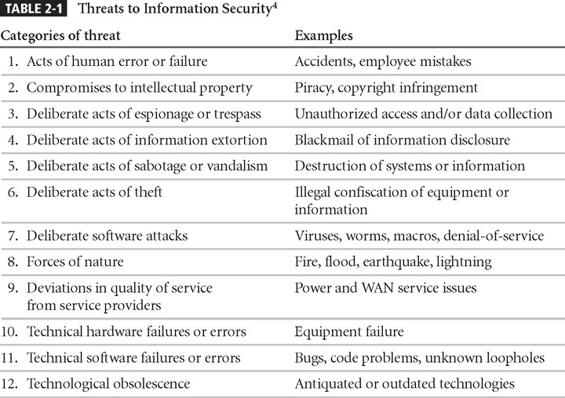
Threats to Information Security

Slide 8
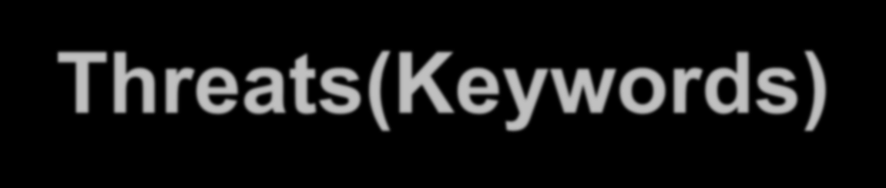

Threats(Keywords)
Spam:-Unsolicited commercial e-mail/Junk e-mail
Cookie:- Small text file that a Web server put on computer
Web Bugs:-a small gif embedded in webpage/email
Malwares:-Malicious Software
Virus(require Some executables), Worms(Self executables), Spyware,
Trojan
Horses, Botnet (Robot Network)
Shoulder Surfing
Hacking:-
Sniffing:- finding
user’s password(Password Sharing, Password
Guessing or Password Capture
Social Engineering:- Vishing(Phone Calls)
Spoofing
Dumpster Diving, Phishing(Email) &
DDoS:-Distributed Denial of Services.
Cybercrime; and Cyber-terrorism.

Slide 9
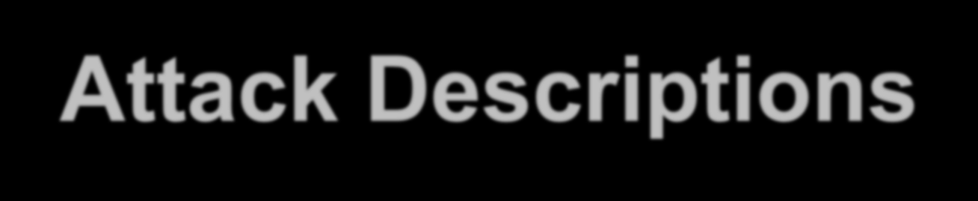
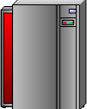

Attack Descriptions
Denial-of-service (DoS) –
attacker sends a large number of connection or information requests to a target
so many requests are made that the target system cannot handle them successfully along with other, legitimate requests for service
may result in a system crash, or merely an inability to perform ordinary functions
Distributed Denial-of-service (DDoS) - an attack in which a coordinated stream of requests is launched against a target from many locations at the same time

Slide 10
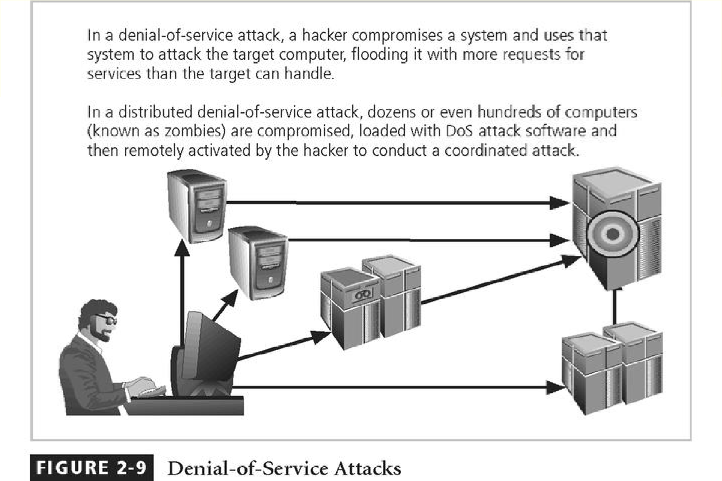


Slide 11
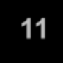
Attack Descriptions
Spoofing - technique used to gain unauthorized access whereby the intruder sends messages to a computer with an IP address indicating that the message is coming from a trusted host
Man-in-the-Middle - an attacker sniffs packets from the network, modifies them, and inserts them back into the network

Slide 12
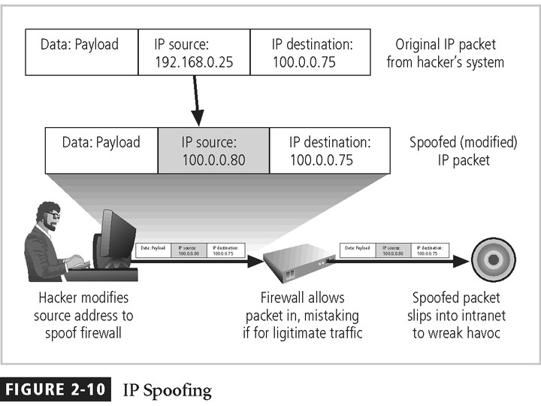
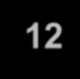

Slide 13
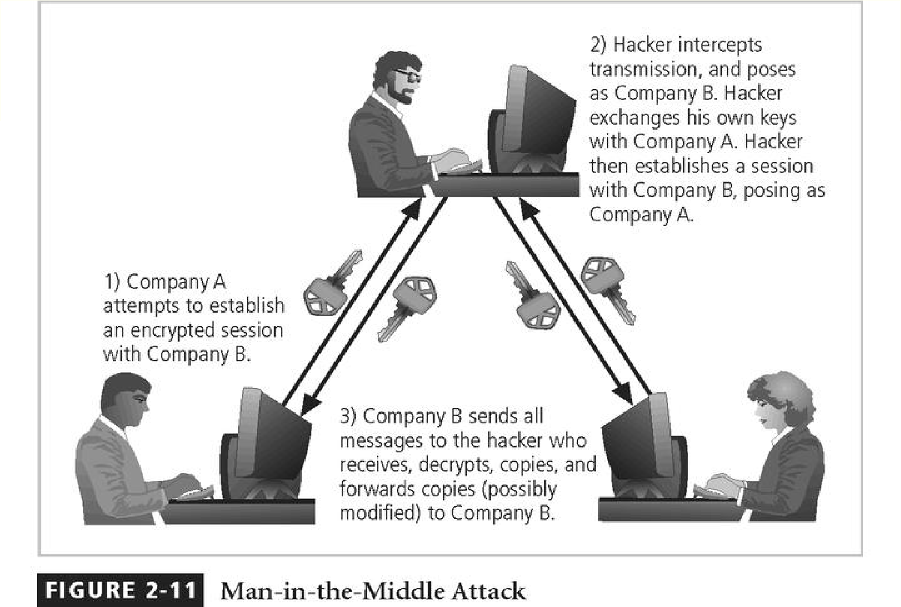
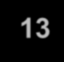

Slide 14

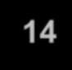
Protective Measures
Bolster Access Control
by using a strong password system. You should have a mix of uppercase and lower case letters, numbers, and special characters.
Also, always reset all default passwords.
Finally, create a strong access control policy.
Keep All Software Updated
From anti-virus software to computer operating systems, ensure your software is updated.
When a new version of software is released, the version usually includes fixes for security vulnerabilities.
Manual software updates can be time-consuming. Use automatic software updates for as many programs as possible.

Slide 15
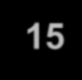
Protective Measures
Standardize Software
Keep your systems protecting by standardizing software like
Operating system, Browser, Media player, Plug-in.
Ensure that users cannot install software onto the system without approval.
Use Network Protection Measures
Install a firewall
Ensure proper access controls
Use IDS/IPS to track potential packet floods
Use network segmentation
Use a virtual private network (VPN)
Conduct proper maintenance

Slide 16
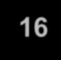
Protective Measures
Employee Training
Sometimes external threats are successful because of an insider threat. The weakest link in data protection can be your own employees.
Ensure your employees understand network security.
Employees should be able to identify threats.
They should also know who to contact to avoid a security breach
Schedule backups
You can schedule backups to external hard drives or in the cloud in order to keep your data stored safely.
The right frequency is weekly but you can do incremental backups every few days.

Slide 17
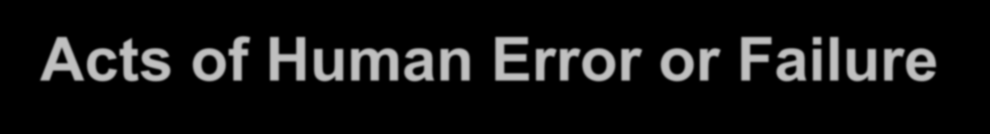

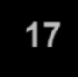
Acts of Human Error or Failure
Includes acts done without malicious intent
Caused by:
Inexperience Improper training Incorrect assumptions Other circumstances
Employees are greatest threats to information security – They are closest to the organizational data

Slide 18
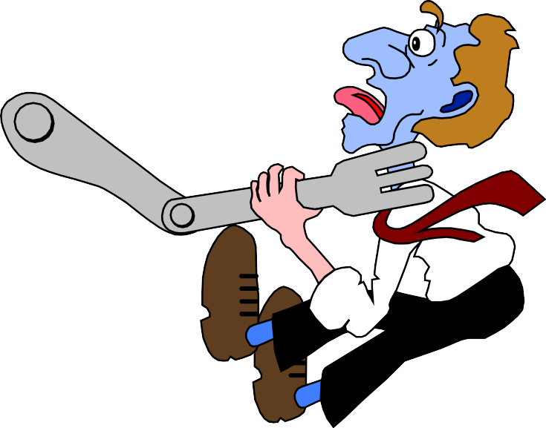
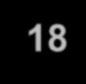
Acts of Human Error or Failure
Employee mistakes can easily lead to the following:
revelation of classified data entry of erroneous data
accidental deletion or modification of data
storage of data in unprotected
areas
failure to protect information
Many of these threats can be prevented with controls

Slide 19


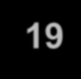
Compromises to Intellectual Property
Intellectual property is “the ownership of ideas and control over the tangible or virtual representation of those ideas”
Many organizations are in business to create intellectual property
trade secrets copyrights trademarks patents

Slide 20

Compromises to Intellectual Property
Most common IP breaches involve software piracy
Watchdog organizations investigate: Software & Information Industry Association (SIIA)
Business Software Alliance (BSA)
Enforcement of copyright has been attempted with technical security mechanisms

Slide 21

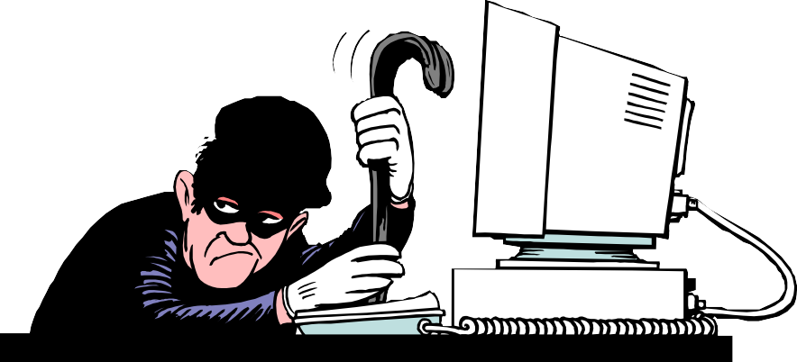

Espionage/Trespass
Broad category of activities that breach confidentiality
Unauthorized accessing of
information
Competitive intelligence vs. espionage
Shoulder surfing can occur any place a person is accessing confidential information
Controls implemented to mark the boundaries of an organization’s virtual territory giving notice to trespassers that they are encroaching on the organization’s cyberspace
Hackers uses skill, guile, or fraud to steal the property of someone else

Slide 22
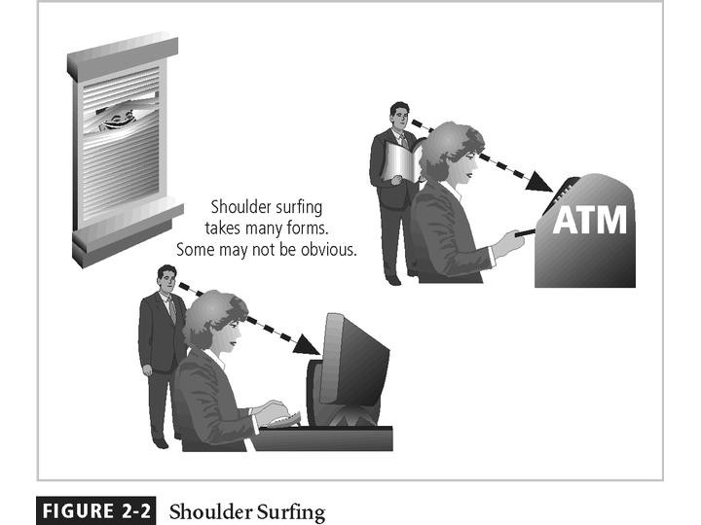


Slide 23

Espionage/Trespass
Generally two skill levels among hackers:
Expert hacker
develops software scripts and codes exploits
usually a master of many skills
will often create attack software and share with others
Script kiddies
hackers of limited skill
use expert-written software to exploit a system
do not usually fully understand the systems they hack
Other terms for system rule breakers:
Cracker - an individual who “cracks” or removes protection designed to prevent unauthorized duplication
Phreaker - hacks the public telephone network

Slide 24
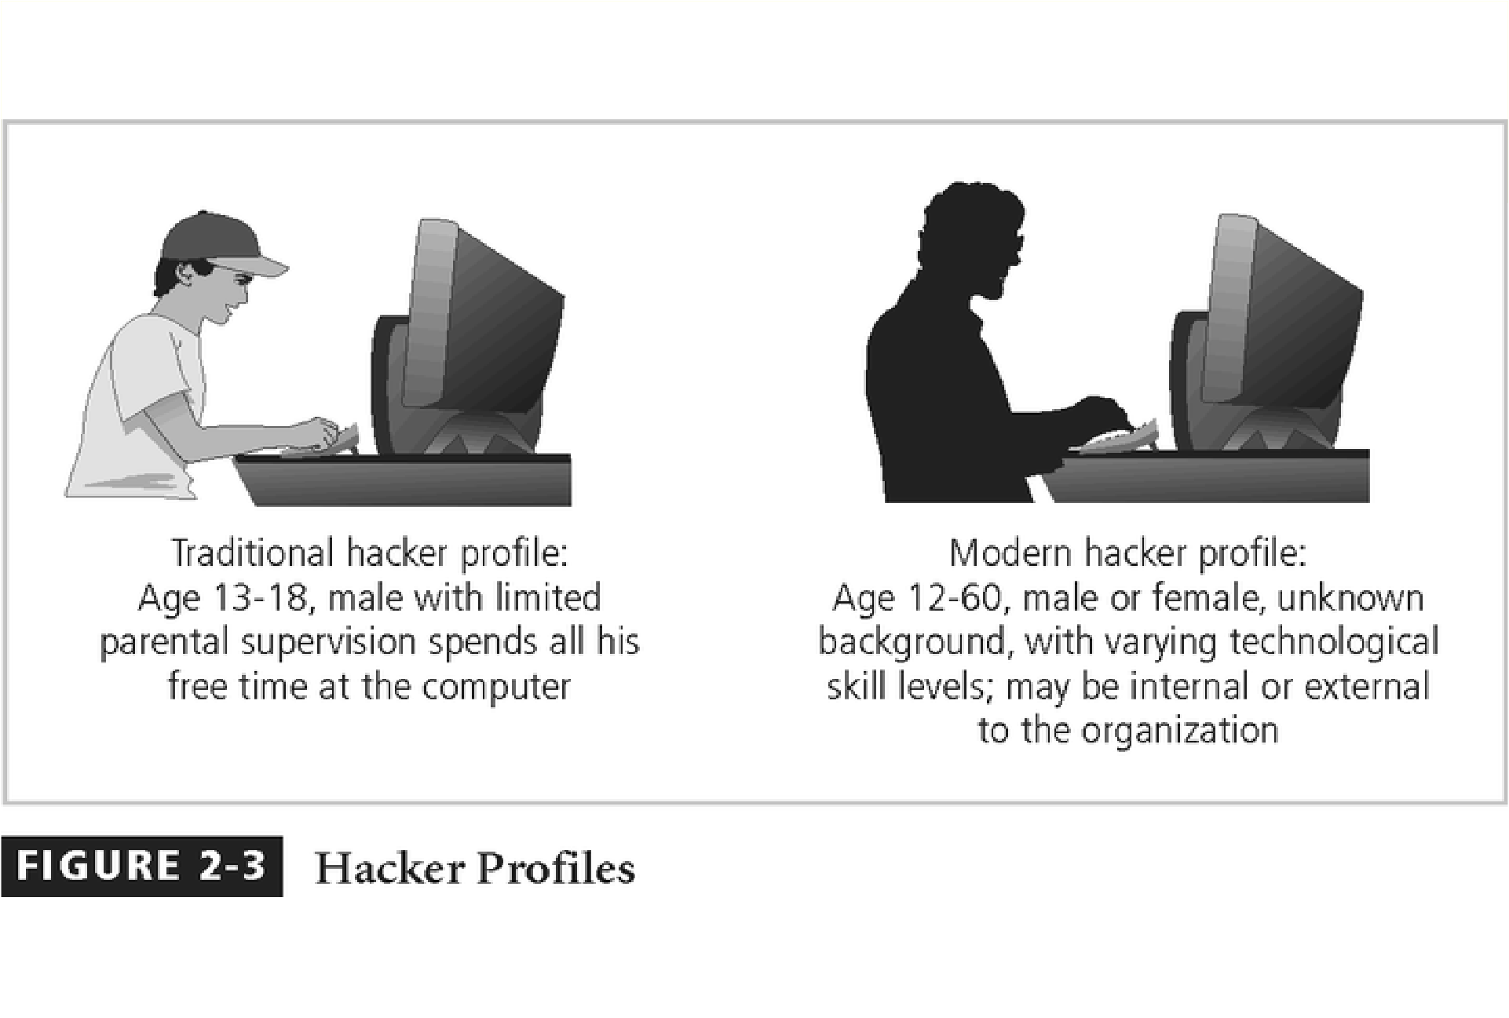
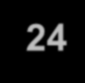

Slide 25

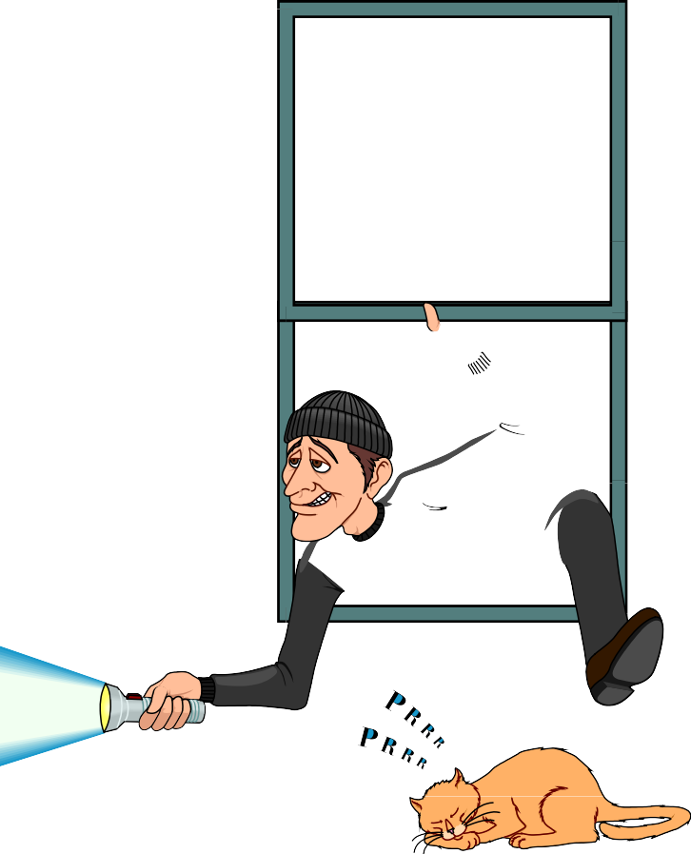



Information Extortion
Information extortion is an attacker or formerly trusted insider stealing information from a computer system and demanding compensation for its return or non-use
Extortion found in credit card number theft

Slide 26
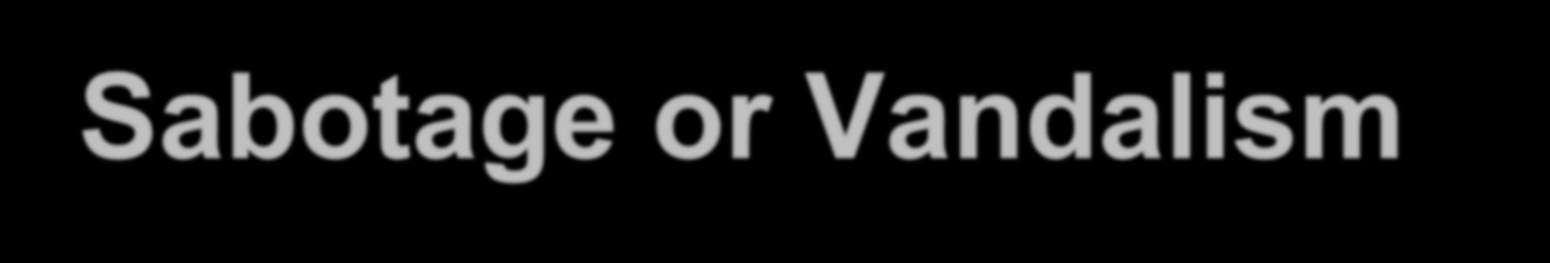
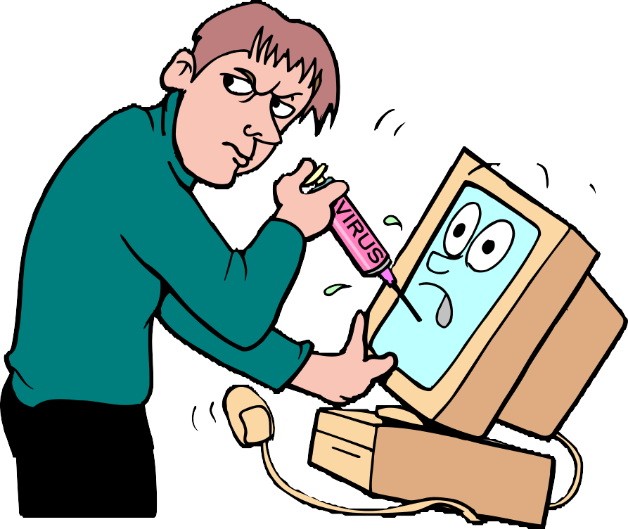

Sabotage or Vandalism
Individual or group who want to deliberately sabotage the operations of a computer system or business, or perform acts of vandalism to either destroy an asset or damage the image of the organization
These threats can range from petty vandalism to organized sabotage
Organizations rely on image so Web defacing can lead to dropping consumer confidence and sales
Rising threat of hacktivist or cyber-activist operations – the most extreme version is cyber- terrorism

Slide 27
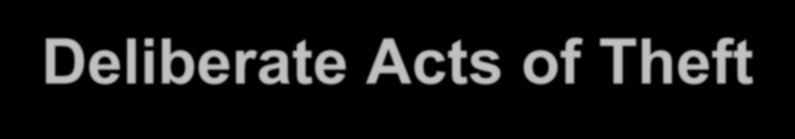

Deliberate Acts of Theft
Illegal taking of another’s property - physical, electronic, or intellectual
The value of information suffers when it is copied and taken away without the owner’s knowledge Physical theft can be controlled - a wide variety of
measures used from locked doors to guards or alarm systems
Electronic theft is a more complex problem to manage and control - organizations may not even know it has occurred

Slide 28


Internet Service Issues
Loss of Internet service can lead to considerable loss in the availability of information
organizations have sales staff and telecommuters working at remote locations
When an organization outsources its web servers, the outsourcer assumes responsibility for
All Internet Services
The hardware and operating system software used to
operate the web site

Slide 29
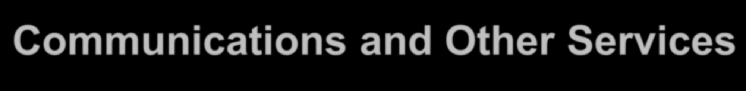

Communications and Other Services
Other utility services have potential impact Among these are
telephone
water & wastewater trash pickup
cable television natural or propane gas custodial services
The threat of loss of services can lead to inability to function properly

Slide 30


Power Irregularities
Voltage levels can increase, decrease, or cease:
spike – momentary increase surge – prolonged increase sag – momentary low voltage brownout – prolonged drop
fault – momentary loss of power blackout – prolonged loss
Electronic equipment is susceptible to fluctuations, controls can be applied to manage power quality

Slide 31



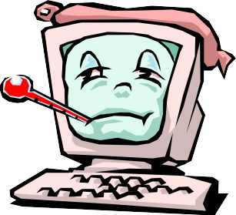

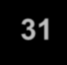
Deliberate Software Attacks
When an individual or group designs software to attack systems, they create malicious code/software called malware
Designed to damage, destroy, or deny service to the target systems
Includes:
macro virus boot virus worms
Trojan horses logic bombs
back door or trap door denial-of-service attacks polymorphic
hoaxes
Trojan Horse
W O R M
Virus
Bomb

Slide 32

Deliberate Software Attacks
Virus is a computer program that attaches itself to an executable file or application.
It can replicate itself, usually through an executable program attached to an e-mail.
The keyword is “attaches”. A virus can not stand on its own.
You must prevent viruses from being installed on computers in your organizations.

Slide 33
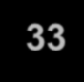
Deliberate Software Attacks
There is no foolproof method of preventing them from attaching themselves to your computer
Antivirus software compares virus signature files against the programming code of know viruses.
Regularly update virus signature files is crucial.

Slide 34
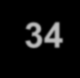
Deliberate Software Attacks
A worm is a computer program that replicates and propagates itself without having to attach itself to a host.
Most infamous worms are Code Red and Nimda. Cost businesses millions of dollars in damage as a result of lost productivity
Computer downtime and the time spent recovering lost data, reinstalling programming's, operating systems, and hiring or contracting IT personnel.

Slide 35
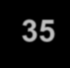
Deliberate Software Attacks
Trojan Programs disguise themselves as useful computer programs or applications and can install a backdoor or rootkit on a computer.
Backdoors or rootkits are computer programs that give attackers a means of regaining access to the attacked computer later.

Slide 36
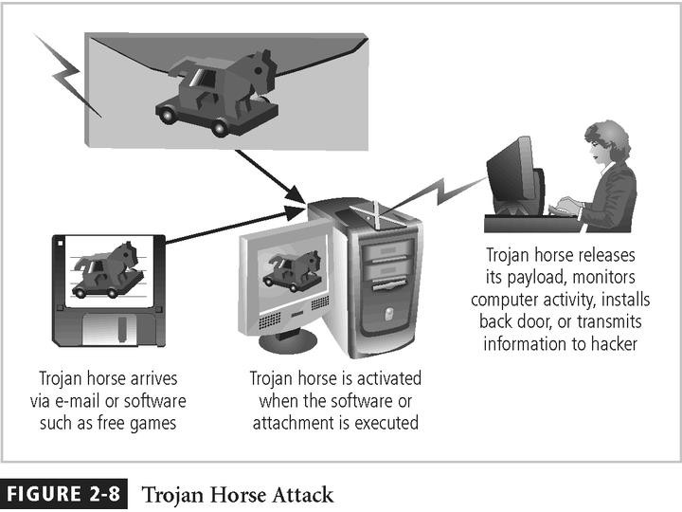
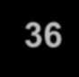

Slide 37
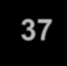
Deliberate Software Attacks
Challenges:
Trojan programs that use common ports, such as TCP 80, or UPD 53, are more difficult to detect.
Many software firewalls can recognize port- scanning program or information leaving a questionable port.
However, they prompt user to allow or disallow, and users are not aware.
Educate your network users.
Many Trajan programs use standard ports to conduct their exploits.

Slide 38

Deliberate Software Attacks
Spyware
A Spyware program sends info from the infected computer to the person who initiated the spyware program on your computer Spyware program can register each keystroke entered.
www.spywareguide.com
Adware
Main purpose is to determine a user’s purchasing habits so that Web
browsers can display advertisements tailored to that user.
Slow down the computer it’s running on.
Adware sometimes displays a banner that notifies the user of its presence
Both programs can be installed without the user being aware
of their presence

Slide 39
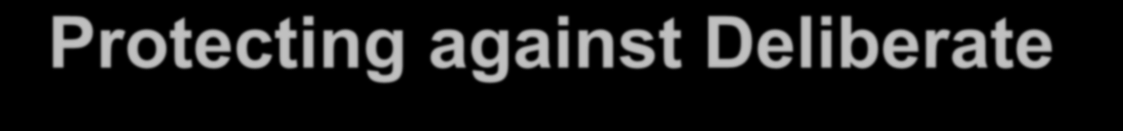


Protecting against Deliberate Software Attacks
Educating Your Users
Many U.S. government organizations make security awareness programs mandatory, and many private-sector companies are following their example.
Email monthly security updates to all employees. Update virus signature files as soon as possible. Protect a network by implementing a firewall.
Avoiding Fear Tactics
Your approach to users or potential customers should be promoting awareness rather than instilling fear.
When training users, be sure to build on the knowledge they already have.

Slide 40


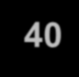
Flloods
Earthquakes Thunderstorms
Tornadoes Vollcanoes
Hurriicanes
Forces of Nature
Wiindstorms Humiidiity
Avallanche
Landslliides
Snowstorms
Fiire
Forces of nature, force majeure, or acts of God are dangerous because they are unexpected and can occur with very little warning
Can disrupt not only the lives of individuals, but also the storage, transmission, and use of information
Include fire, flood, earthquake, and lightning as well as volcanic eruption and insect infestation
Since it is not possible to avoid many of these threats, management must implement controls to limit damage and also prepare contingency plans for continued operations

Slide 41


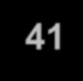
Deviations in Quality of Service by Service Providers
Situations of product or services not delivered as expected
Information system depends on many inter- dependent support systems
Three sets of service issues that dramatically affect the availability of information and systems are
Internet service Communications Power irregularities

Slide 42
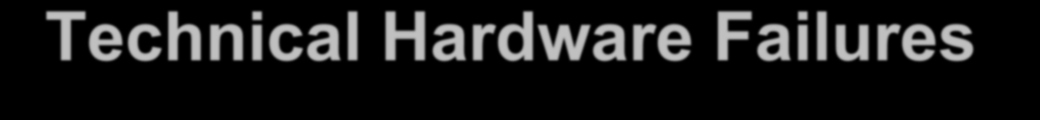

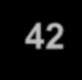
Technical Hardware Failures or Errors
Technical hardware failures or errors occur when a manufacturer distributes to users equipment containing flaws
These defects can cause the system to perform outside of expected parameters, resulting in unreliable service or lack of availability
Some errors are terminal, in that they result in the unrecoverable loss of the equipment
Some errors are intermittent, in that they only periodically manifest themselves, resulting in faults that are not easily repeated

Slide 43
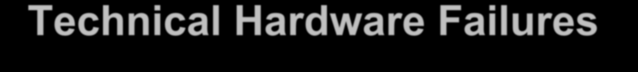

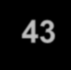
Technical Hardware Failures or Errors
This category of threats comes from purchasing software with unrevealed faults
Large quantities of computer code are written, debugged, published, and sold only to determine that not all bugs were resolved
Sometimes, unique combinations of certain software and hardware reveal new bugs
Sometimes, these items aren’t errors, but are purposeful shortcuts left by programmers for honest or dishonest reasons

Slide 44
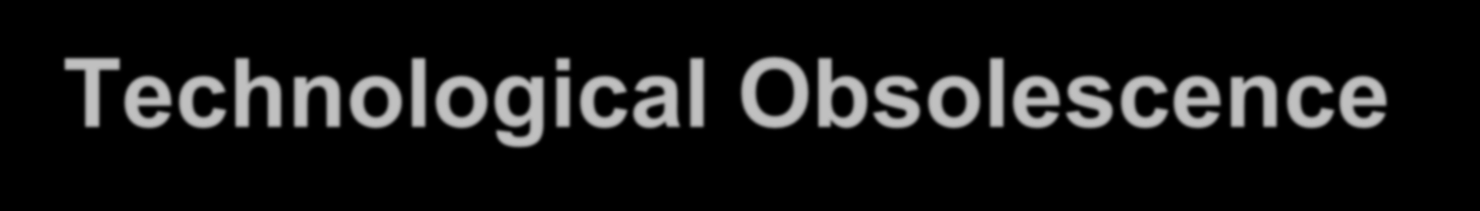
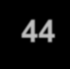
Technological Obsolescence
When the infrastructure becomes antiquated or outdated, it leads to unreliable and untrustworthy systems
Management must recognize that when technology becomes outdated, there is a risk of loss of data integrity to threats and attacks
Ideally, proper planning by management should prevent the risks from technology obsolesce, but when obsolescence is identified, management must take action

Slide 45


Attacks
An attack is the deliberate act that exploits vulnerability
It is accomplished by a threat-agent to damage or
steal an organization’s information or physical asset
An exploit is a technique to compromise a system
A vulnerability is an identified weakness of a controlled system whose controls are not present or are no longer effective
An attack is then the use of an exploit to achieve the
compromise of a controlled system

Slide 46



Malicious Code
This kind of attack includes the execution of viruses, worms, Trojan horses, and active web scripts with the intent to destroy or steal information
The state of the art in attacking systems in 2002 is the multi- vector worm using up to six attack vectors to exploit a variety of vulnerabilities in commonly found information system devices

Slide 47



Slide 48

Attack Descriptions
IP Scan and Attack – Compromised system scans random or local range of IP addresses and targets any of several vulnerabilities known to hackers or left over from previous exploits
Web Browsing - If the infected system has write access to any Web pages, it makes all Web content files infectious, so that users who browse to those pages become infected
Virus - Each infected machine infects certain common executable or script files on all computers to which it can write with virus code that can cause infection

Slide 49

Attack Descriptions
Unprotected Shares - using file shares to copy viral component to all reachable locations
Mass Mail - sending e-mail infections to addresses found in address book
Simple Network Management Protocol - SNMP vulnerabilities used to compromise and infect
Hoaxes - A more devious approach to attacking computer systems is the transmission of a virus hoax, with a real virus attached

Slide 50

Attack Descriptions
Back Doors - Using a known or previously unknown and newly discovered access mechanism, an attacker can gain access to a system or network resource
Password Crack - Attempting to reverse calculate a password
Brute Force - The application of computing and network resources to try every possible combination of options of a password
Dictionary - The dictionary password attack narrows the field by selecting specific accounts to attack and uses a list of commonly used passwords (the dictionary) to guide guesses

Slide 51

Attack Descriptions
Denial-of-service (DoS) –
attacker sends a large number of connection or information requests to a target
so many requests are made that the target system cannot handle them successfully along with other, legitimate requests for service
may result in a system crash, or merely an inability to perform ordinary functions
Distributed Denial-of-service (DDoS) - an attack in which a coordinated stream of requests is launched against a target from many locations at the same time

Slide 52


Slide 53

Attack Descriptions
Spoofing - technique used to gain unauthorized access whereby the intruder sends messages to a computer with an IP address indicating that the message is coming from a trusted host
Man-in-the-Middle - an attacker sniffs packets from the network, modifies them, and inserts them back into the network
Spam - unsolicited commercial e-mail - while many consider spam a nuisance rather than an attack, it is emerging as a vector for some attacks

Slide 54


Slide 55


Slide 56

Attack Descriptions
Mail-bombing - another form of e-mail attack that is also a DoS, in which an attacker routes large quantities of e-mail to the target
Sniffers - a program and/or device that can monitor data traveling over a network. Sniffers can be used both for legitimate network management functions and for stealing information from a network
Social Engineering - within the context of information security, the process of using social skills to convince people to reveal access credentials or other valuable information to the attacker

Slide 57


Attack Descriptions
“People are the weakest link. You can have the best technology; firewalls, intrusion- detection systems, biometric devices ... and somebody can call an unsuspecting employee. That's all she wrote, baby. They got everything.”
“brick attack” – the best configured firewall in the world can’t stand up to a well placed brick

Slide 58

Attack Descriptions
Buffer Overflow –
application error occurs when more data is sent to a
buffer than it can handle
when the buffer overflows, the attacker can make the target system execute instructions, or the attacker can take advantage of some other unintended consequence of the failure
Usually the attacker fill the overflow buffer with executable program code to elevate the attacker’s permission to that of an administrator.

Slide 59

Attack Descriptions
Ping of Death Attacks --
A type of DoS attack
Attacker creates an ICMP packet that is larger than the maximum allowed 65,535 bytes.
The large packet is fragmented into smaller packets and reassembled at its destination.
Destination user cannot handle the reassembled oversized papcket, thereby causing the system to crash or freeze.

Slide 60

Attack Descriptions
Timing Attack –
relatively new
works by exploring the contents of a web browser’s cache can allow collection of information on access to password- protected sites
another attack by the same name involves attempting to intercept cryptographic elements to determine keys and encryption algorithms

